Slide 1



SMART INDIA HACKATHON 2024
Localized Legal Research Platform for Indian Courts
Problem Statement ID: SIH1701
Problem Statement Title:
AI-Driven Research Engine for Commercial Courts
Theme: Smart Automation
PS Category: Software
Team ID - RMKSIH24SW104
Team Name: AI Alchemists

Slide 2
Localized Legal Research Platform for Indian Courts
AI Alchemists
Proposed Solution (Describe your Idea/Solution/Prototype)
Multimodal and Multilingual Support: Handles diverse data and multiple languages for comprehensive legal insights.
Comprehensive Data Analysis: Quickly provides relevant insights by aggregating and analyzing past cases, laws, and past case hearings.
Customized Reports: Produces tailored reports summarizing case details and evidence to save time.
Predictive Insights: Forecasts case outcomes using historical data to support informed decisions.
Ethical and Localized AI: Ensures transparency and adapts recommendations to local laws and the Indian Constitution in a secured environment using NightFall AI.
Data Localization: Aligns analysis with regional laws and procedures, relevant across High Courts and the Supreme Court in India.
@SIH Idea submission- Template
2

Slide 3
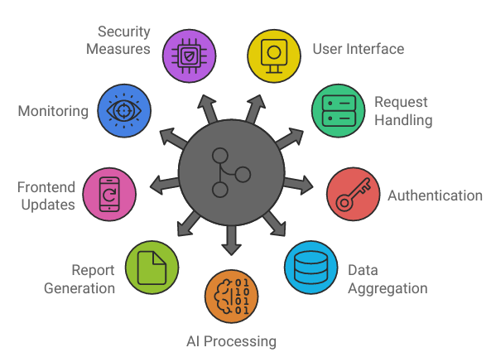
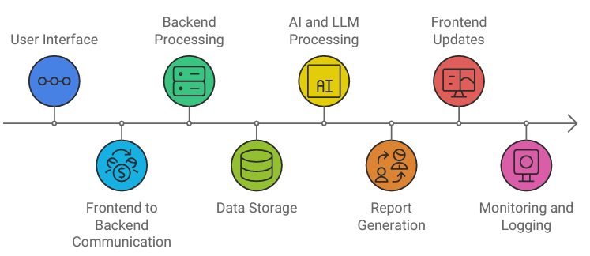
AI Alchemists
TECHNICAL APPROACH
AI Frameworks: InLegalBert, Langchain and HuggingFace (LLMs)
Backend Framework: Node.js, Firebase, NightFall and FastAPI.
Frontend Framework: Gradio, React, TailwindCSS, Framer and Bootstrap.
Database: MongoDB, Pinecones, .
Flowchart
@SIH Idea submission- Template
3

Slide 4
AI Alchemists
FEASIBILITY AND VIABILITY
Feasibility of AI Integration
Analysis: Leveraging Langchain and LLMs for NLP and predictive analytics to enhance legal research efficiency.
Strategy: Implement proof-of-concept to validate AI model performance and integration.
Data Localization and Compliance
Analysis: Customizing for regional laws and procedures across different High Courts and the Supreme Court is complex but essential.
Strategy: Develop a modular system with flexible data handling to adapt to local legal requirements.
Multilingual Support
Analysis: Supporting multiple languages requires robust language models and translation capabilities.
Strategy: Utilize established multilingual libraries and continually update language models.
Data Security and Privacy
Analysis: Ensuring the security and privacy of sensitive legal data is critical.
Strategy: Implement strong encryption, access controls, and compliance with data protection regulations.
User Adoption and Training
Analysis: Judges and judicial officers may need training to effectively use the new system.
Strategy: Provide comprehensive training sessions and user-friendly documentation.
@SIH Idea submission- Template
@SIH Idea submission- Template
4

Slide 5
AI Alchemists
IMPACT AND BENEFITS
Accelerated Case Resolution: Speeds up legal proceedings, reducing case backlog and improving judicial efficiency.
Enhanced Legal Accuracy: Provides precise insights and predictive analytics, aiding in more accurate case outcomes.
Improved Access to Justice: Makes legal research more accessible to judges, fostering fairer and faster decisions.
Reduced Administrative Burden: Automates research and report generation, saving time for judicial officers and reducing administrative workload.
Economic Efficiency: Decreases legal costs by streamlining processes and reducing delays, benefiting businesses and individuals.
Localized and Ethical Standards: Adapts to regional laws and ensures fairness, enhancing trust in the legal system and aligning with local practices.
@SIH Idea submission- Template
5

Slide 6
AI Alchemists
RESEARCH AND REFERENCES
Paramanu-Ayn: An Efficient Novel Generative and Instruction-tuned Language Model for Indian Legal Case Documents, Mitodru Niyogi - Gyan AI Research & MBZUAI, Abu Dhabi, UAE & Arnab Bhattacharya Dept. of Computer Science & Engineering, Indian Institute of Technology Kanpur, India & Gyan AI Research.
Lai, Jinqi & Gan, Wensheng & Wu, Jiayang & Qi, Zhenlian & Yu, Philip. (2023). Large Language Models in Law
Choi, Jonathan H., How to Use Large Language Models for Empirical Legal Research (August 9, 2023). Journal of Institutional and Theoretical Economics (Forthcoming), Minnesota Legal Studies Research Paper No. 23-23,
Hussain, Atin & Thomas, Anu. (2024). Large Language Models for Judicial Entity Extraction: A Comparative Study.
Zadgaonkar, Ashwini & Agrawal, Avinash. (2021). An overview of information extraction techniques for legal document analysis and processing. International Journal of Electrical and Computer Engineering (IJECE).
R. F. Erbacher and J. Mulholland, "Identification and Localization of Data Types within Large-Scale File Systems," Second International Workshop on Systematic Approaches to Digital Forensic Engineering (SADFE'07), Bell Harbor, WA, USA, 2007, pp. 55-70, doi: 10.1109/SADFE.2007.12.
Khan, Syed & Zakir, Muhammad & Bashir, Sobia & Ali, Rafia. (2024). Artificial Intelligence and Machine Learning in Legal Research: A Comprehensive Analysis. Qlantic Journal of Social Sciences.
@SIH Idea submission- Template

